Slide 1

Presented By:
Tejaswini Natekar
Nikita Ramtere
Aditi Manpure
Vidya Thange
Ankita Shingare

Slide 2
Agenda
Introduction
Features
Benefits
Database Diagram
Operations on Table
Conclusion

Slide 3
Introduction
An inventory management system is a software-based solution designed to help businesses effectively track, manage, and control their inventory or stock levels.
It encompasses a range of tools and functionalities aimed at streamlining various aspects of inventory management, from tracking inventory movements to optimizing stock levels and facilitating inventory-related processes such as ordering, receiving, picking, packing, and shipping.

Slide 4

Features
Inventory Tracking
Stock Management
Order Processing
Supplier Management
Inventory Forecasting

Slide 5

Benefits
Improved Efficiency
Optimized Inventory Levels
Enhanced Accuracy

Slide 6
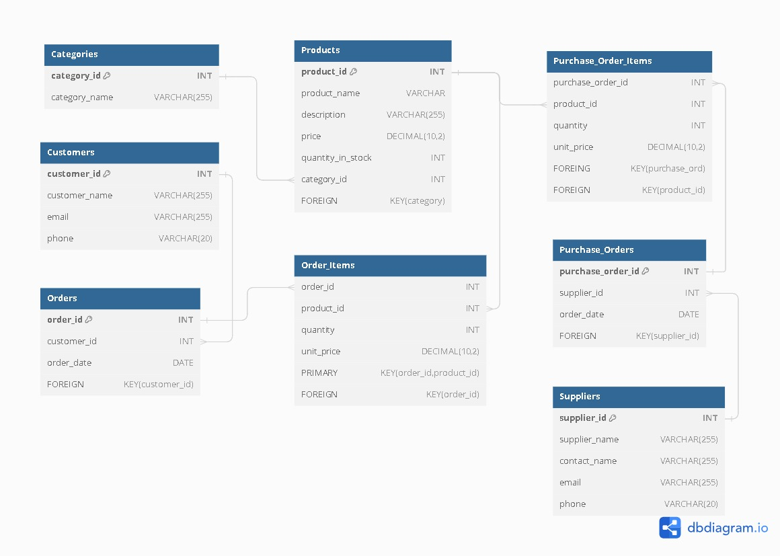

Database Diagram

Slide 7

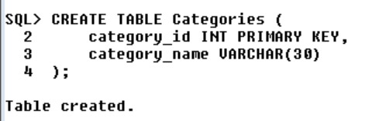
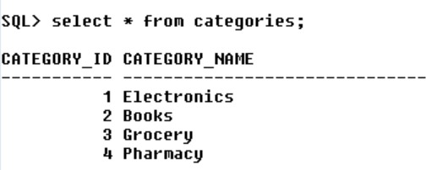
Operations on Table
CATEGORIES TABLE

Slide 8

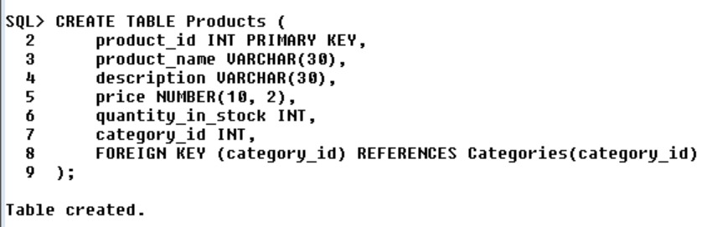
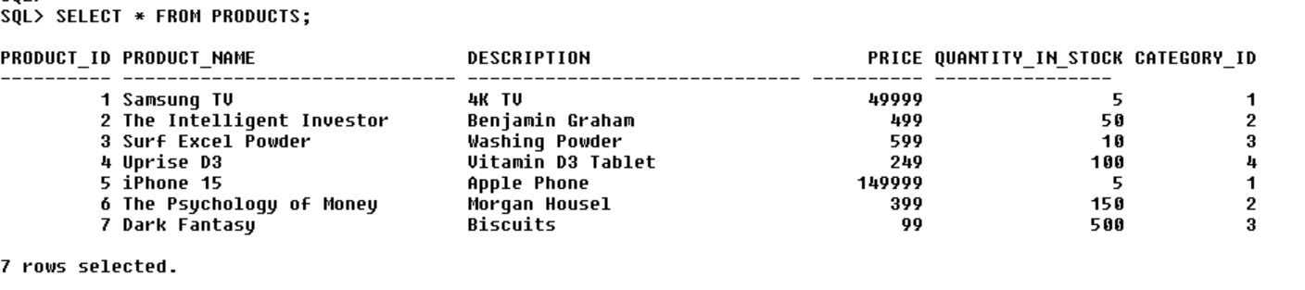
PRODUCTS TABLE

Slide 9

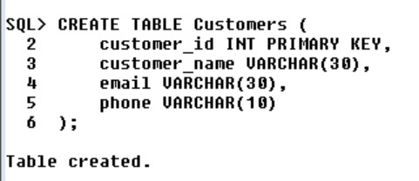
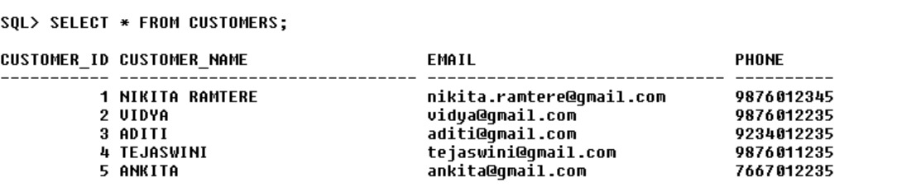
CUSTOMERS TABLE

Slide 10
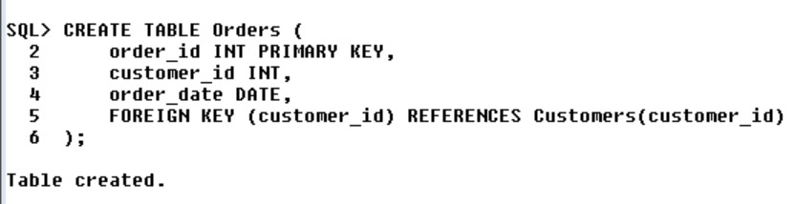

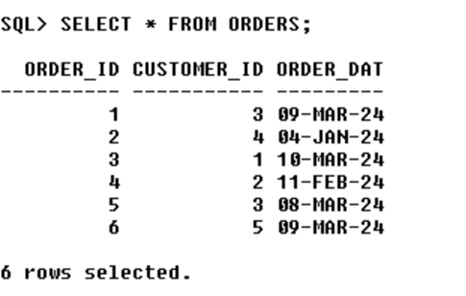
ORDERS TABLE

Slide 11
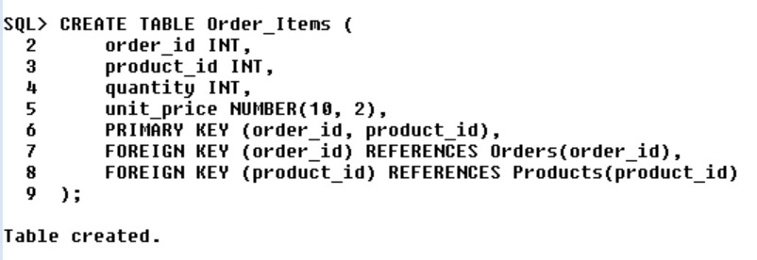

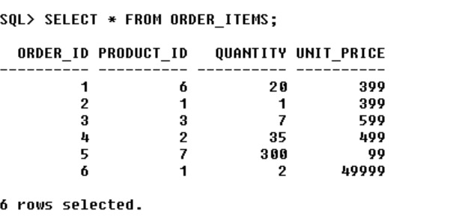
ORDER_ITEMS TABLE

Slide 12

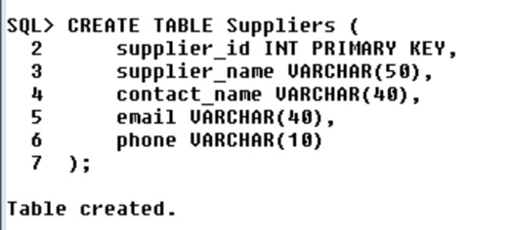
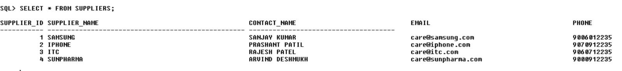
SUPPLIERS TABLE

Slide 13
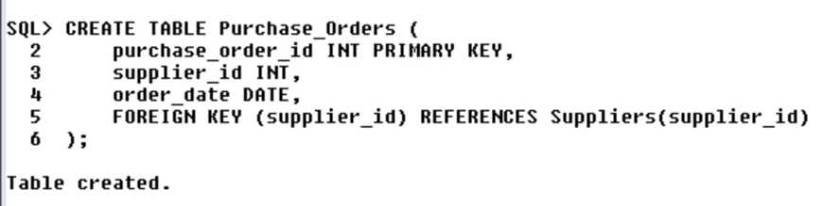
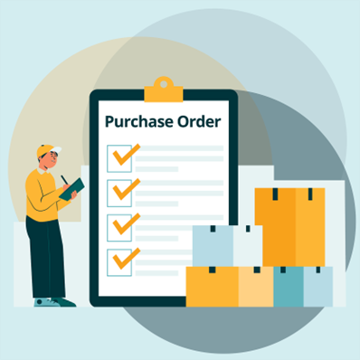
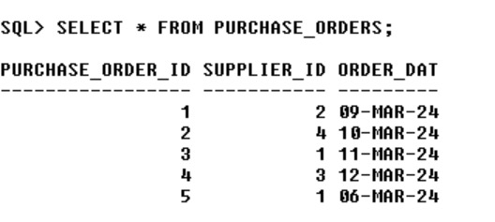
PURCHASE_ORDERS TABLE

Slide 14
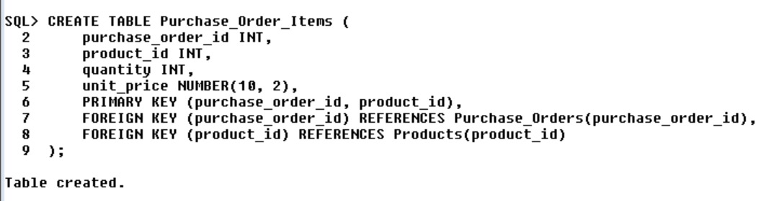
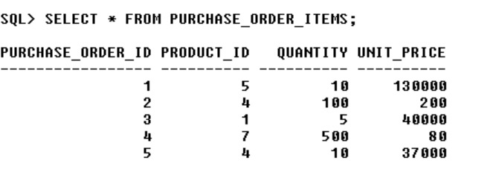
PURCHASE_ORDER_ITEMS TABLE

Slide 15
conclusion
1. The Inventory Management System using SQL is a strategic response to the challenges of manual inventory tracking.
2. This project aligns with the need for businesses to adopt advanced technologies for better control and decision-making.

Slide 16



UNDER GUIDANCE OF
KING OF SQL
RaviTeja Sir

Slide 17


Slide 18


